Slide 1
PORT PREDICTION To develop a predictive probability model that uses port movement data to determine the next port a vessel is likely to sail to

Slide 2
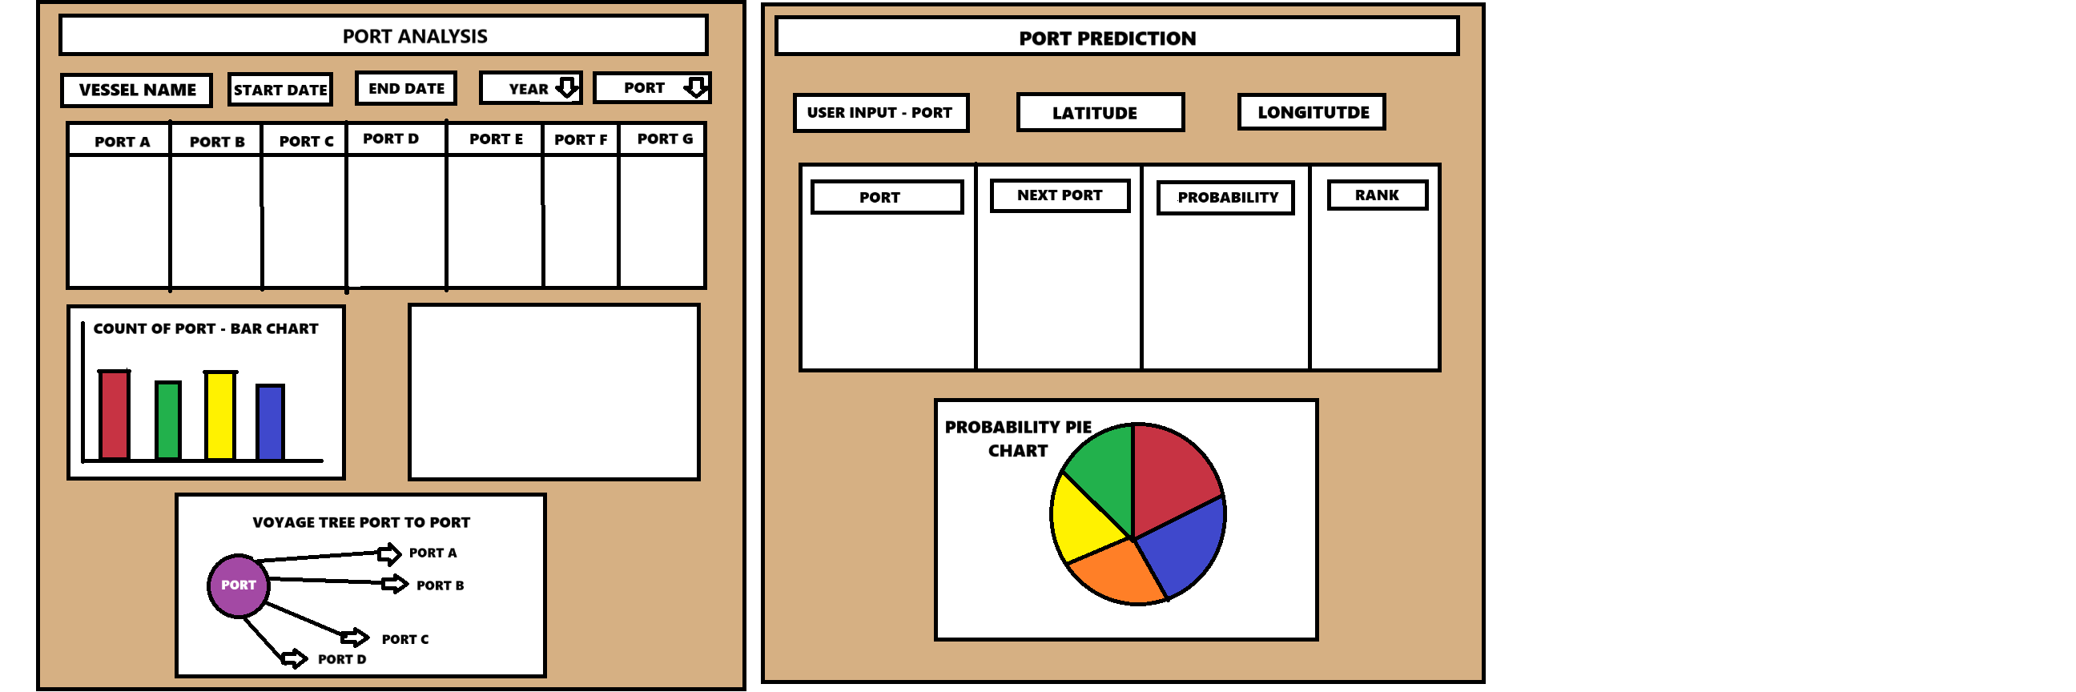

Slide 3
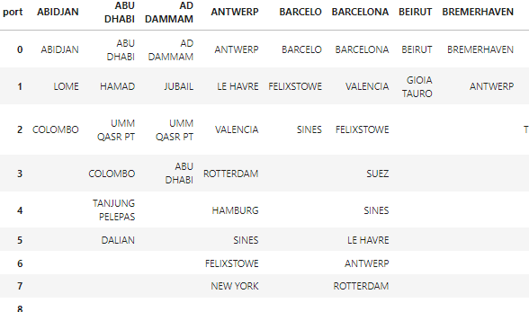

Slide 4
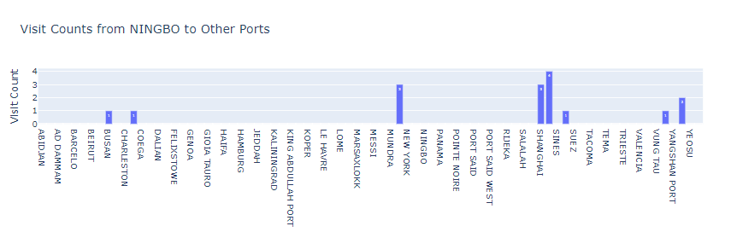

Slide 5
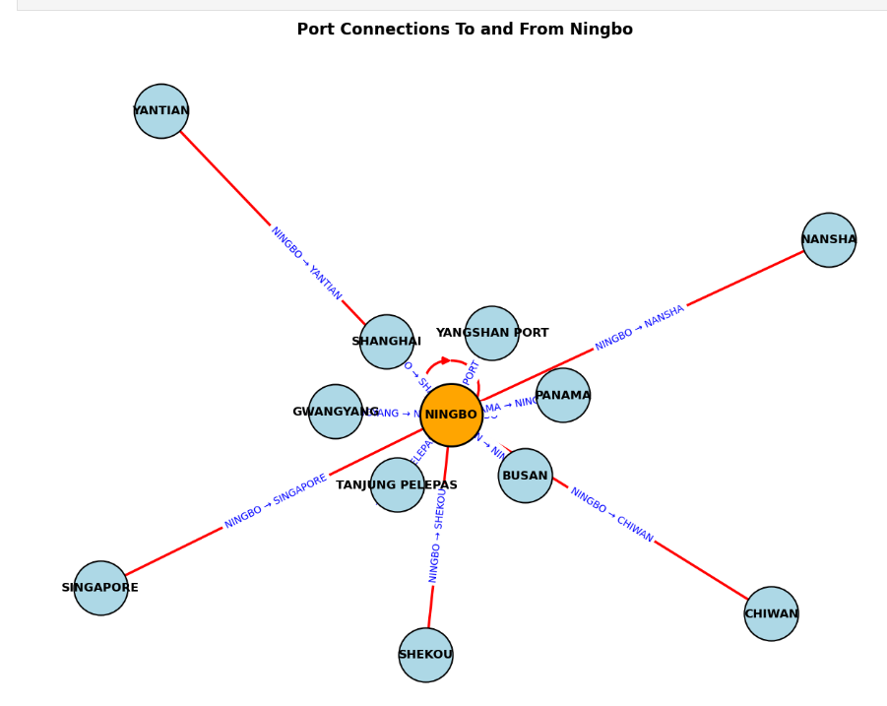

Slide 6
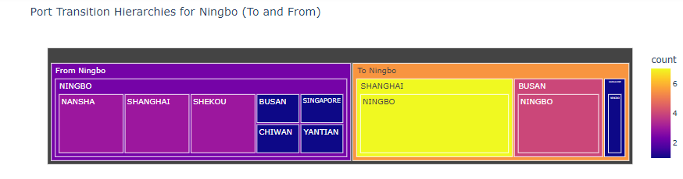

Slide 7
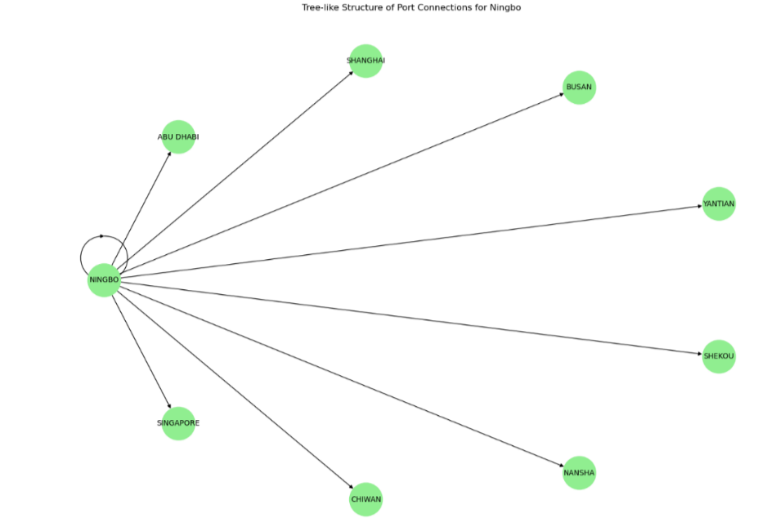

Slide 8
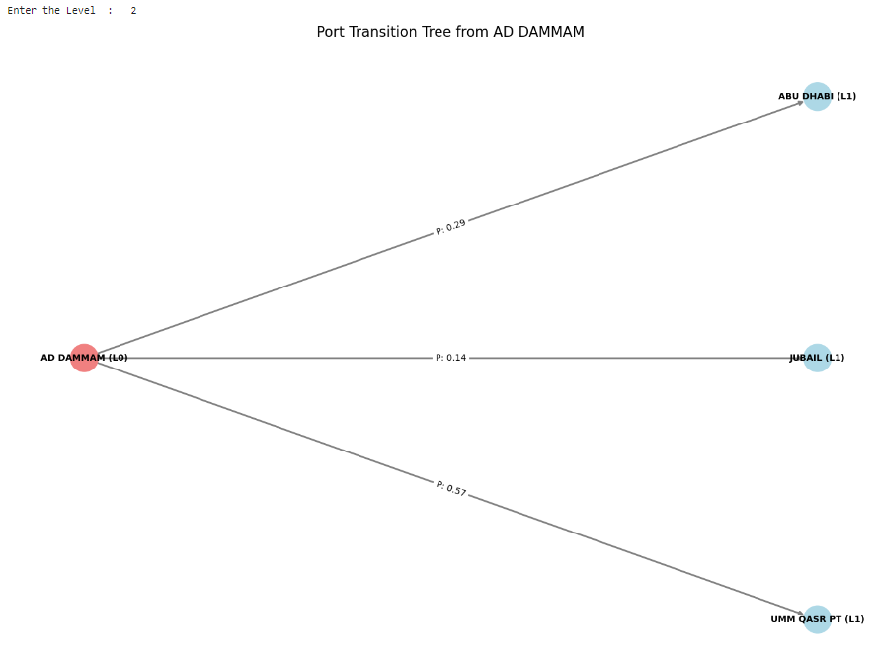

Slide 9
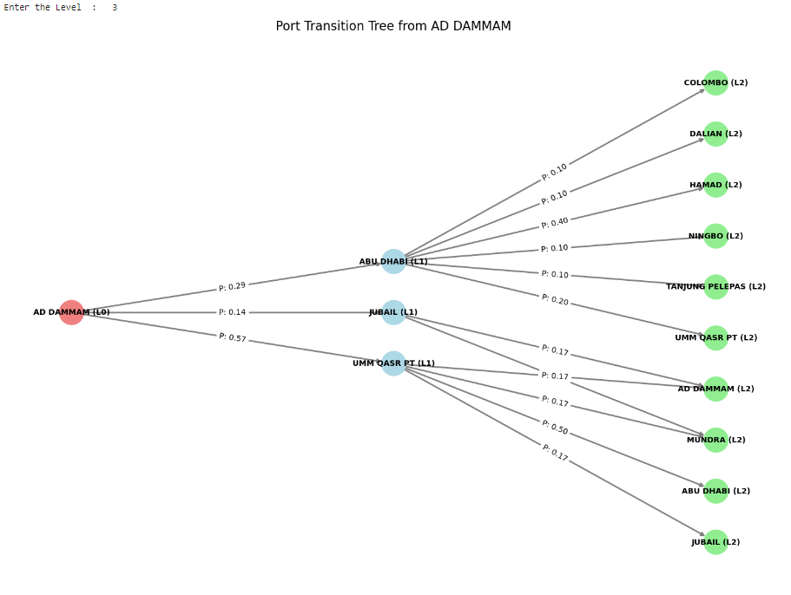

Slide 10
MARKOV CHAIN: A Markov chain is a stochastic model created by Andrey Markov that outlines the probability associated with a sequence of events occurring based on the state in the previous event.
Even Google’s page rank algorithm, which determines what links to show first in its search engine, is a type of Markov chain.
The main goal of the Markov process is to identify the probability of transitioning from one state to another.
Transition Matrix:
Denoted as “P,” This NxN matrix represents the probability distribution of the state’s transitions. The sum of probabilities in each row of the matrix will be one, implying that this is a stochastic matrix.

Slide 11
p
ij = Total number of transitions from state i / Number of transitions from state i to state j
​
After tracking the customers, you observe:
Out of 100 customers who bought Product A, 50 stayed with Product A, 30 switched to Product B, and 20 switched to Product C.
Out of 200 customers who bought Product B, 120 stayed with Product B, 50 switched to Product A, and 30 switched to Product C.
Out of 300 customers who bought Product C, 200 stayed with Product C, 40 switched to Product A, and 60 switched to Product B.
Key Properties of a Transition Matrix
Non-negative entries: All entries so they are between 0 and 1.
Row sums to 1: The sum of each row must be 1, since the system must transition to one of the states.

Slide 12
Markov Chains are good at modeling systems where the next state (port) depends only on the current state (the port the ship is currently at) and not on the previous states (other ports the ship has visited), they can help predict which port a vessel is likely to visit next.
In Markov Chains, if a vessel is at Port A right now, we only use the transition probabilities from Port A to determine the next port. We do not look at the vessel's history, like whether it was previously at Port B or Port C before reaching Port A.

